Slide 1


Slide 2
Problem Description
Expensive rides
Fine for cancelling rides
Manual Ride Booking System still exists
Parcel sending not available through cabs
No app available for instant lift services

Slide 3
Proposed System
Less manpower, less human error
No paperwork
Less formalities
No cancellation charges
Send parcels with rides
Cheaper rides at your finger tip
Reduced response time

Slide 4
Feasibility Study
Technical Feasibility
Operational Feasibility
Economical Feasibility

Slide 5
Technical Feasibility
System Particulars:
Website
Platform Independent
Works with GPS
Requires Location access
Requires Internet
Development Tools:
HTML, CSS
PHP Server
SQL Server
Apache Web Server (HTTP Server)
Domain
Browser

Slide 6
Operational Feasibility
The main goal of this project is to provide a system that will be useful and beneficial to the user/client.
All the requirements needed for this system requires and necessary to the client requests.
Thus, this system acquires information inputs from the user and generates reports so that the client can monitored their entire vehicle, drivers and booking transactions information.
The system’s main goal will result an easier work environment for the company as well as for the employees.
The information acquired from the user will be safely stored in one database and be well monitored.
Because the system generates reports from an automatic way, the generated report as well as the information provided would be accurate.

Slide 7
Economical Feasibility
In the economical feasibility, the development cost in creating the system is evaluated against the ultimate benefit derived from the new systems.
Financial benefits must equal or exceed the costs.
The organization needed not spend much more for the development of the system already available.
The only thing is to be done is making an environment for the development with an effective supervision.
If we are doing so, we can attain the maximum usability of the corresponding resources.

Slide 8
Amount
Bill
B. Id
1
generates
B. Id
A. Id
1
receive
Booking
Details
send
1
1
M
receives
U. Id
ER Diagram
S. Point
1
B. Id
E. Point
System
(Admin)
A. Id
M
Trip
manages
1
U. Id
V. Id
D. Id
creates
D. Id
M
Mob No
Mob No
Name
V. Name
Name
User
A. Id
Name
U. Id
V. Type
Mob No
1
L. Name
1
has a
Is a
1
Vehicle
Driver
Customer
Is from
Location
1
1
1
1

Slide 9
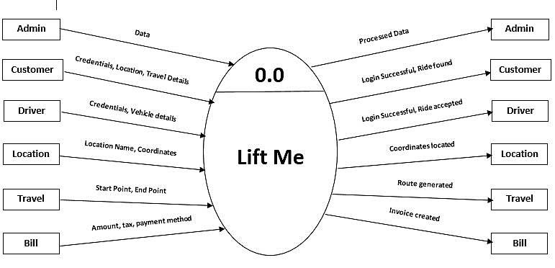
Context Level DFD

Slide 10
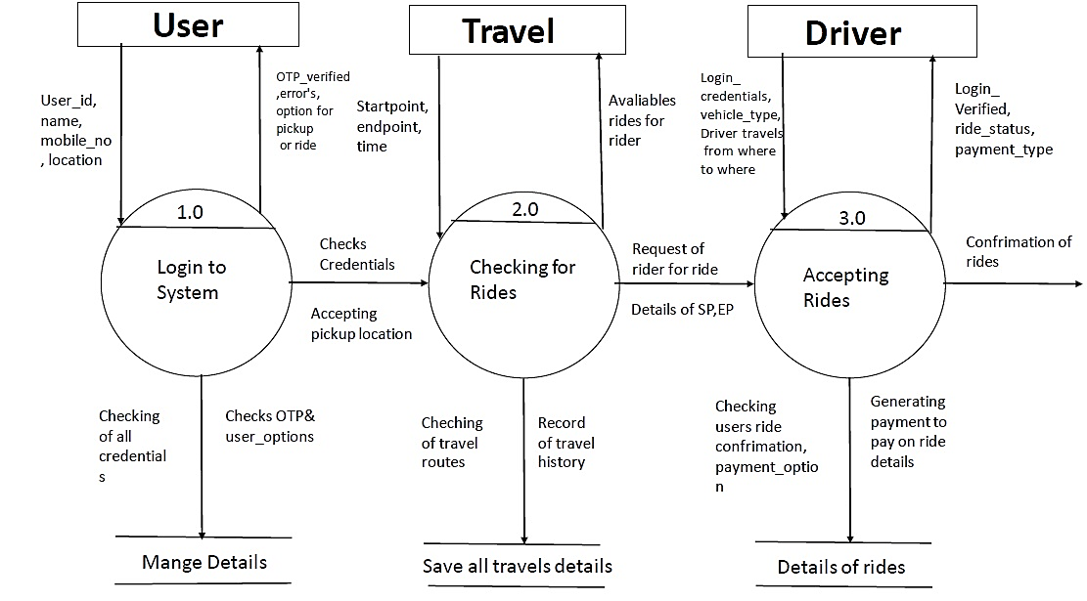
1st Level
DFD

Slide 11
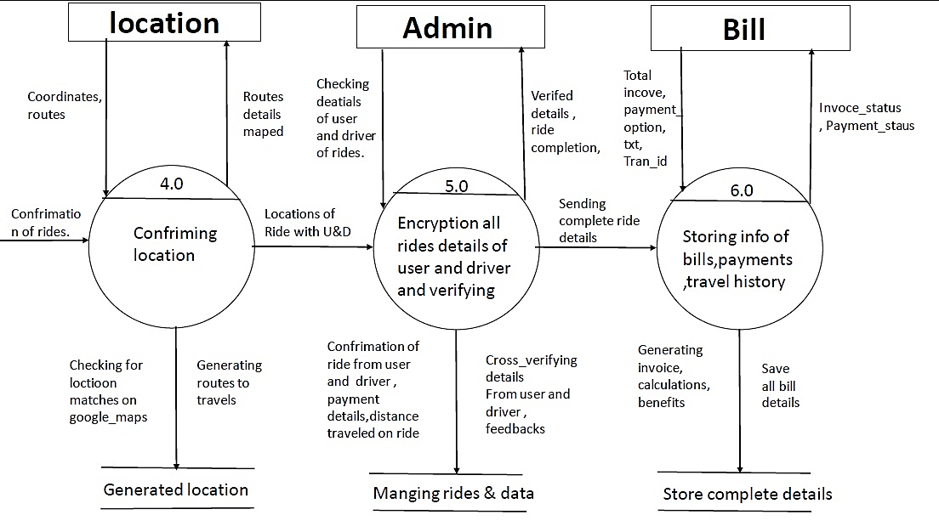

Slide 12
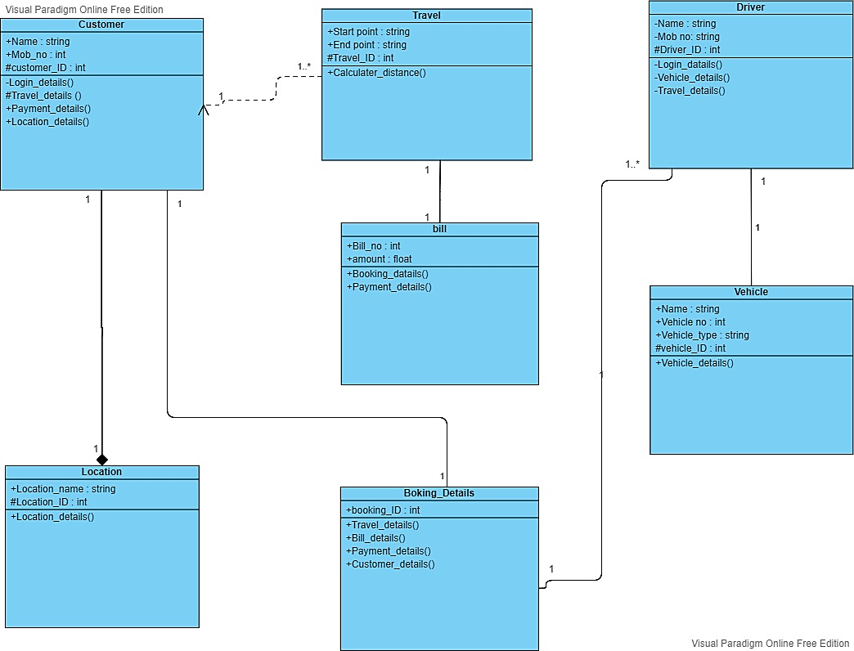
Class Diagram

Slide 13
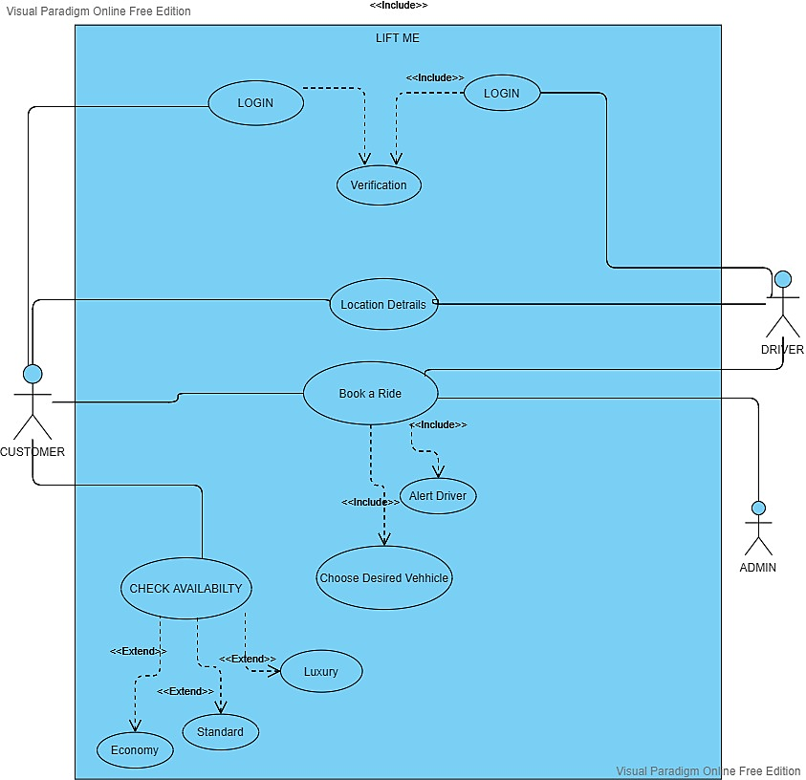
Use Case Diagram

Slide 14
lo
lo
Login
Authentication
lo
Home
page
Login Successful
lo
lo
Types of
rides
Option
Book
ride
Route, location,
passenger, ride type
Ride accepted
Payment mode
lo
lo
Contact
Us
Enter Details
Activity Diagram
Ride Details
Ride booking confirmation

Slide 15
Booking Confirmation
Confirmation
Details
Travel Details
Journey
Status
Payment Mode
Payment details
Payment Status
Bill Details
Invoice
Feedback
Rating

Slide 16
Sequence Diagram
Customer
Driver
System
Database
Login
Login Successful
Login Details
Login
Customer, Driver verification
Login Successful
Requests Cab, Travel Route
Driver, Customer Routes
Rides details to Take ride
Ride Approval for journey
Routes & rides details
Customer Routes & details
Booking Confirmation
Payment Mode
Payment mode, Route
Ride Details, Route, Invoice
Ride Confirmation & Charges
Location verification, Invoice
Ride Details, Invoice
Feedback, Rating
Ride Status ,Payment
Feedback, Travel History, Ratings
Ride Payment, Ratings

Slide 17
<< Device >>
: DB Server
Deployment Diagram
<< Artifact >>
Postgres SQL DB
<< Device >>
: Customer
<< Device >>
: Web Server
<< Device >>
: Driver
<< Artifact >>
:Website
<< Device >>
: Browser
<< Artifact >>
HTML

Slide 18
Input/Output Screens

Slide 19
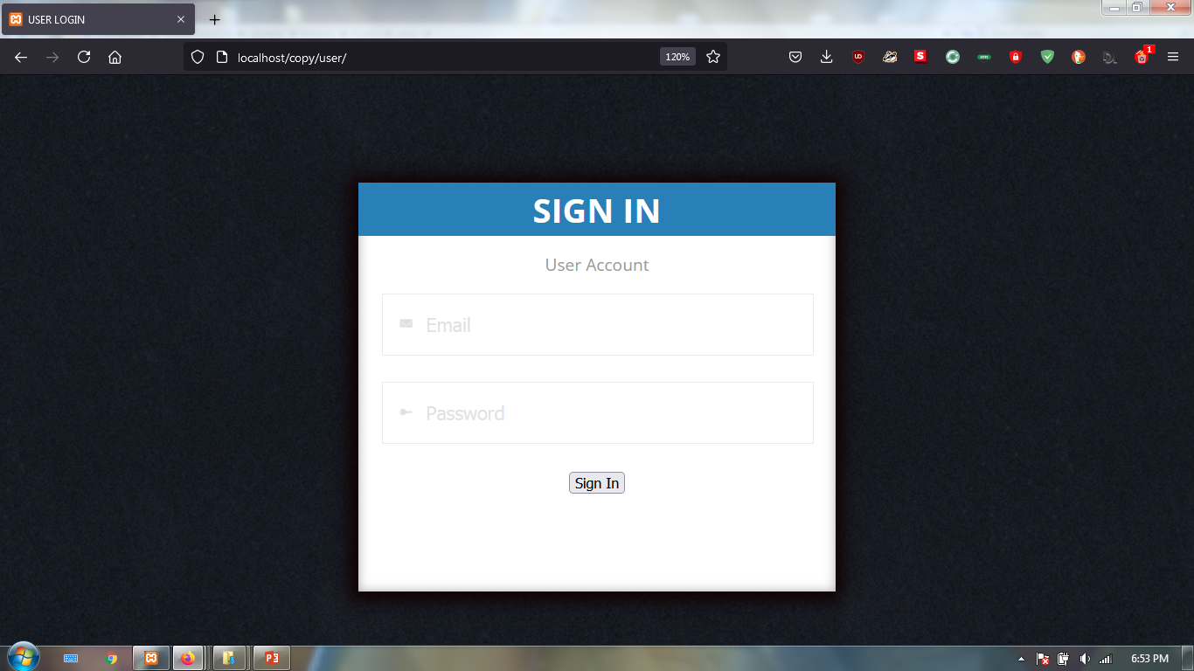

Slide 20
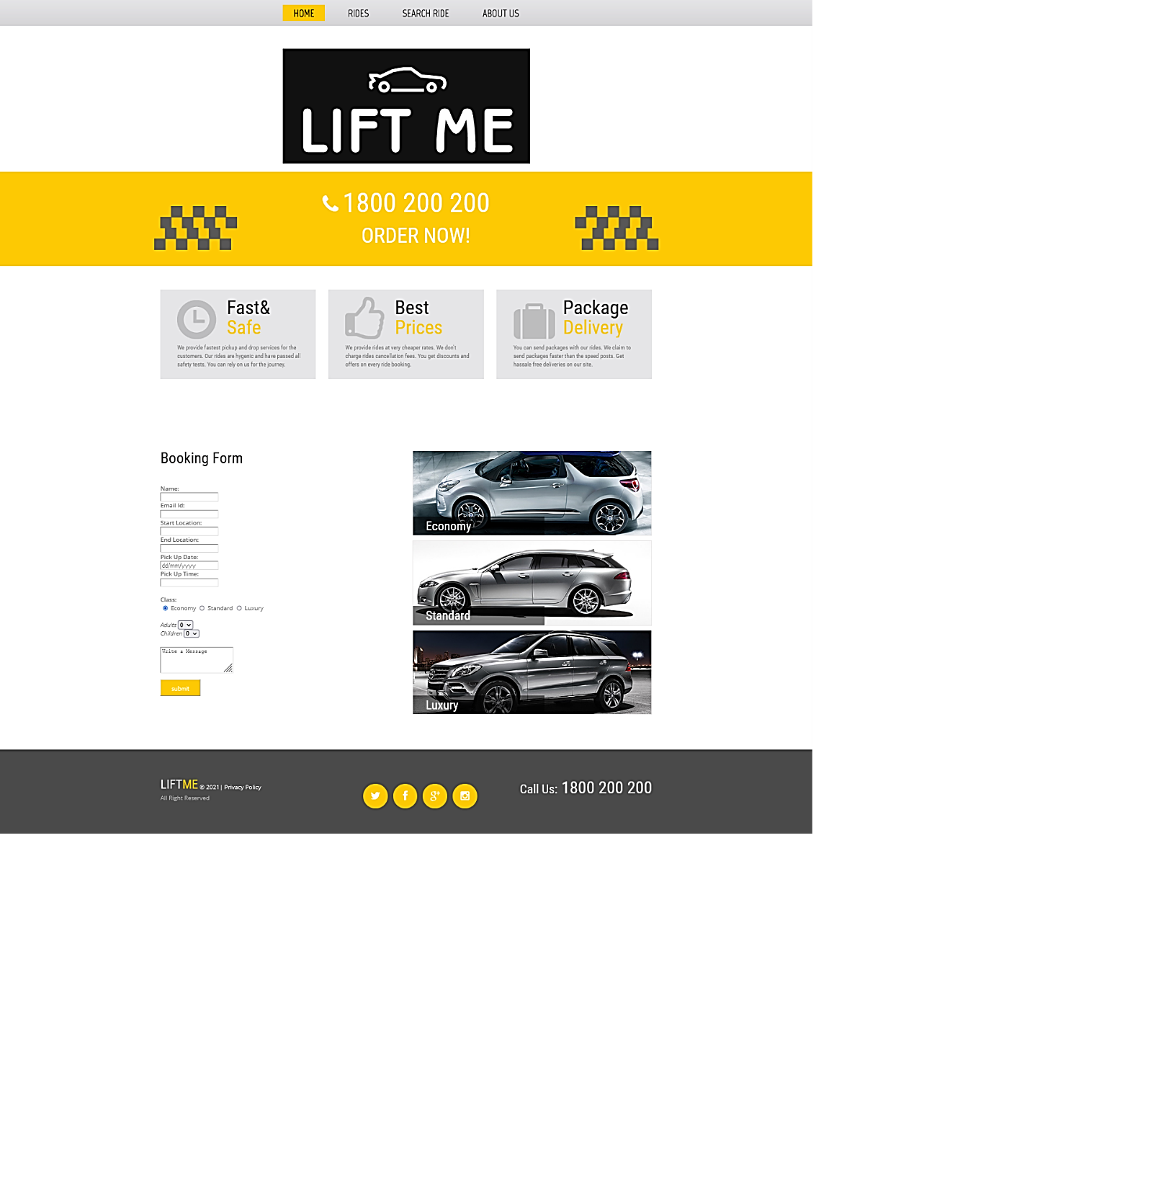

Slide 21
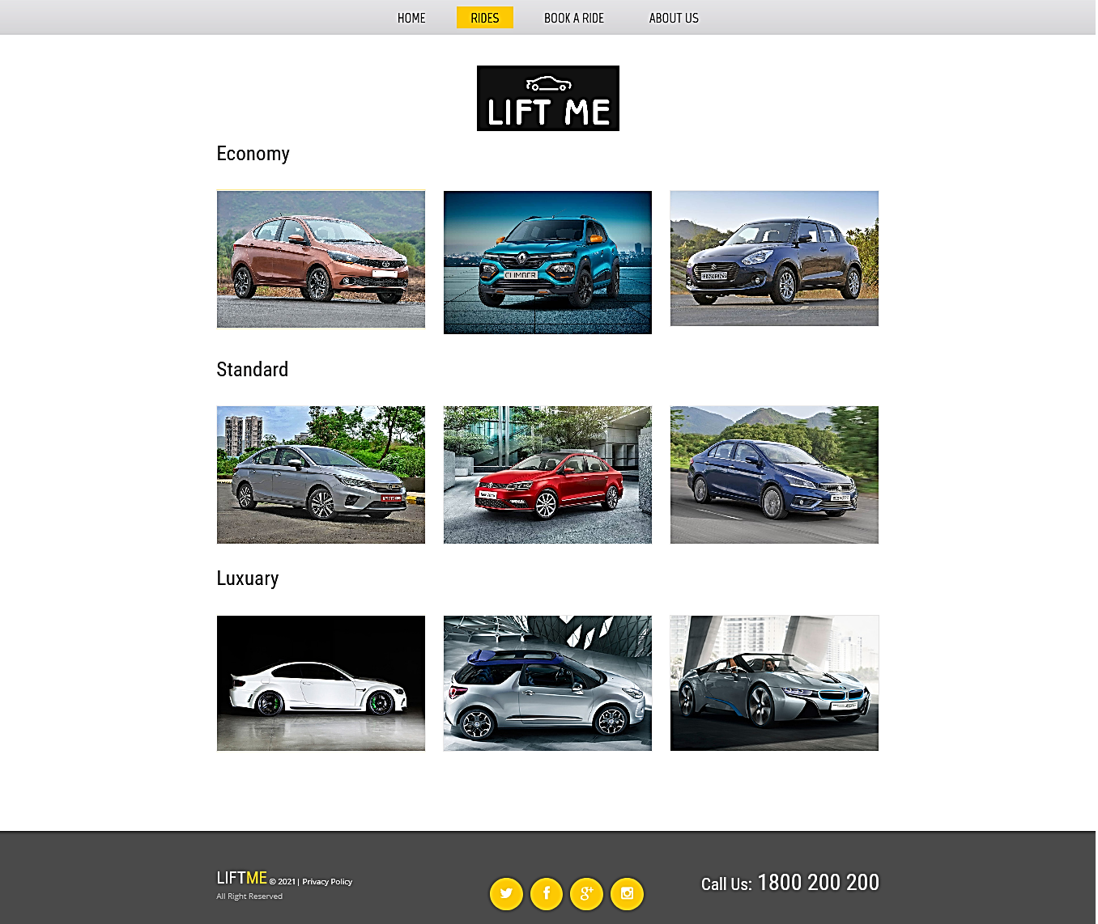

Slide 22
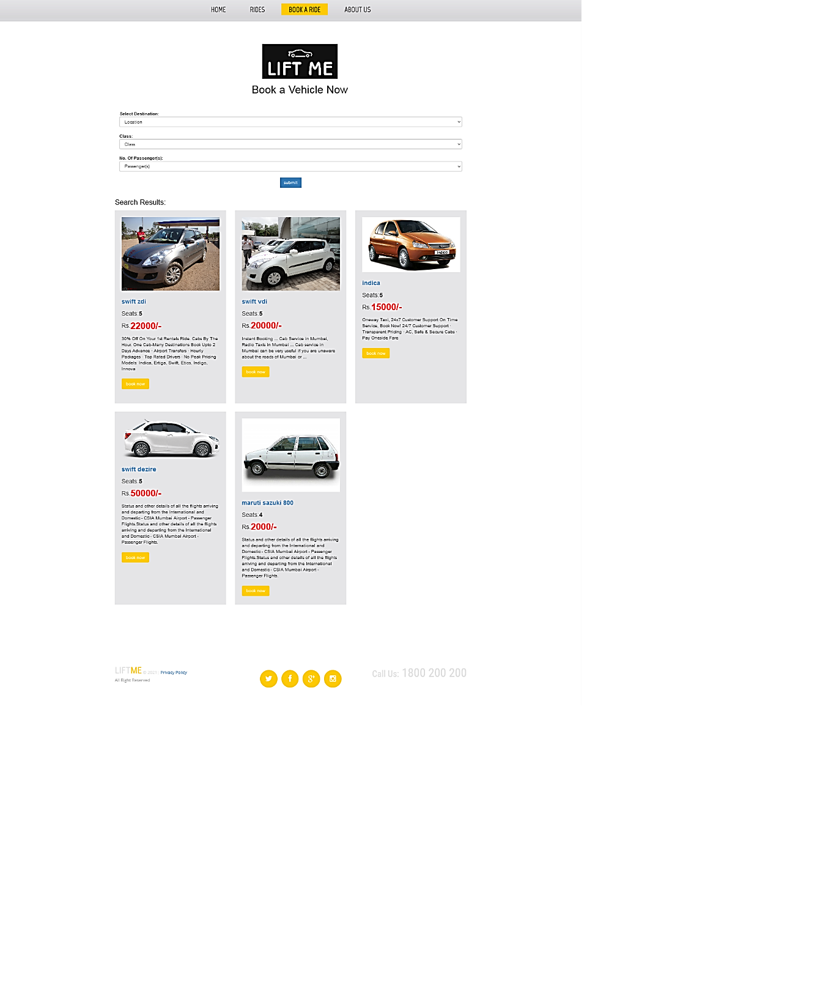

Slide 23
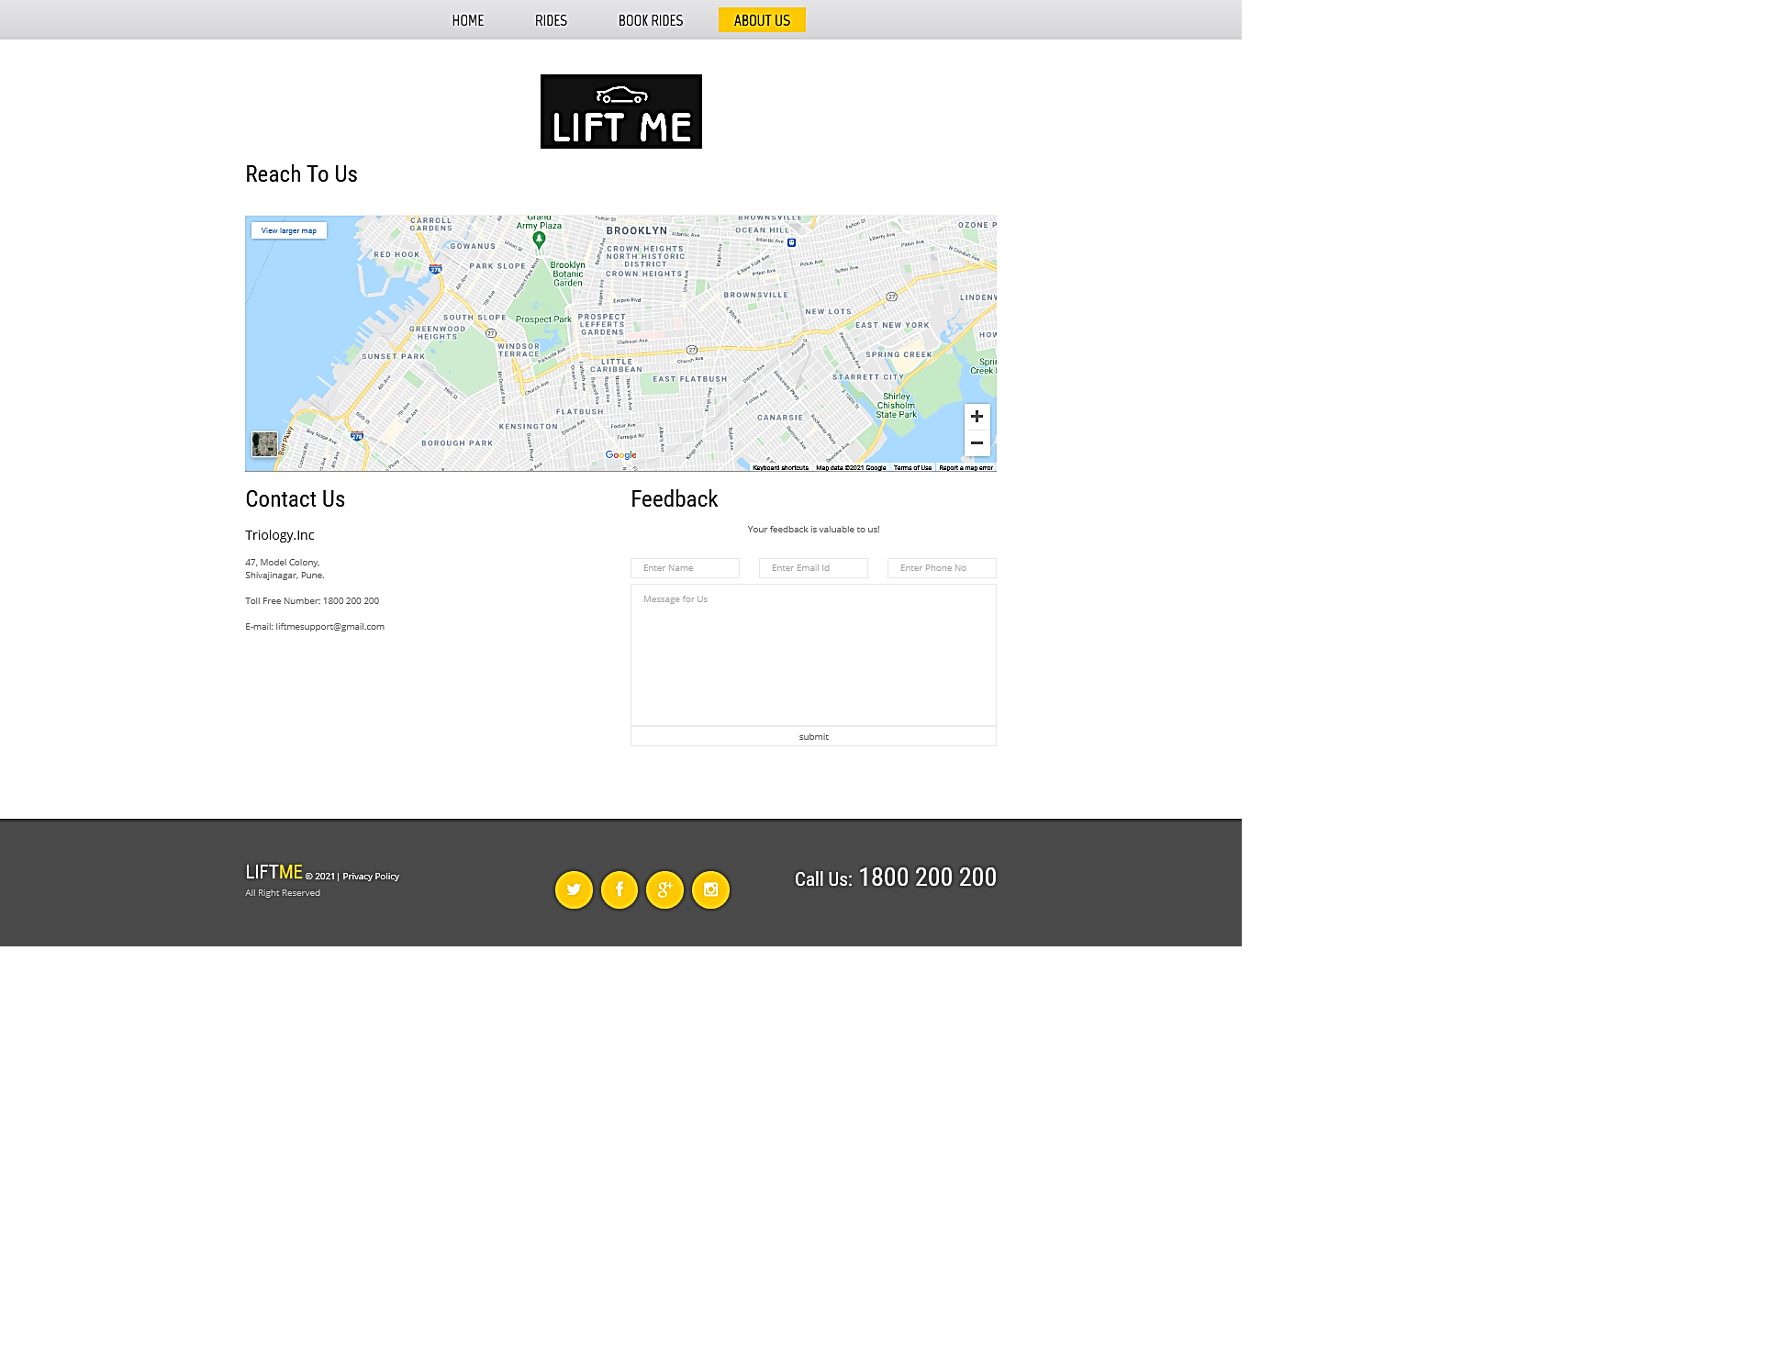

Slide 24
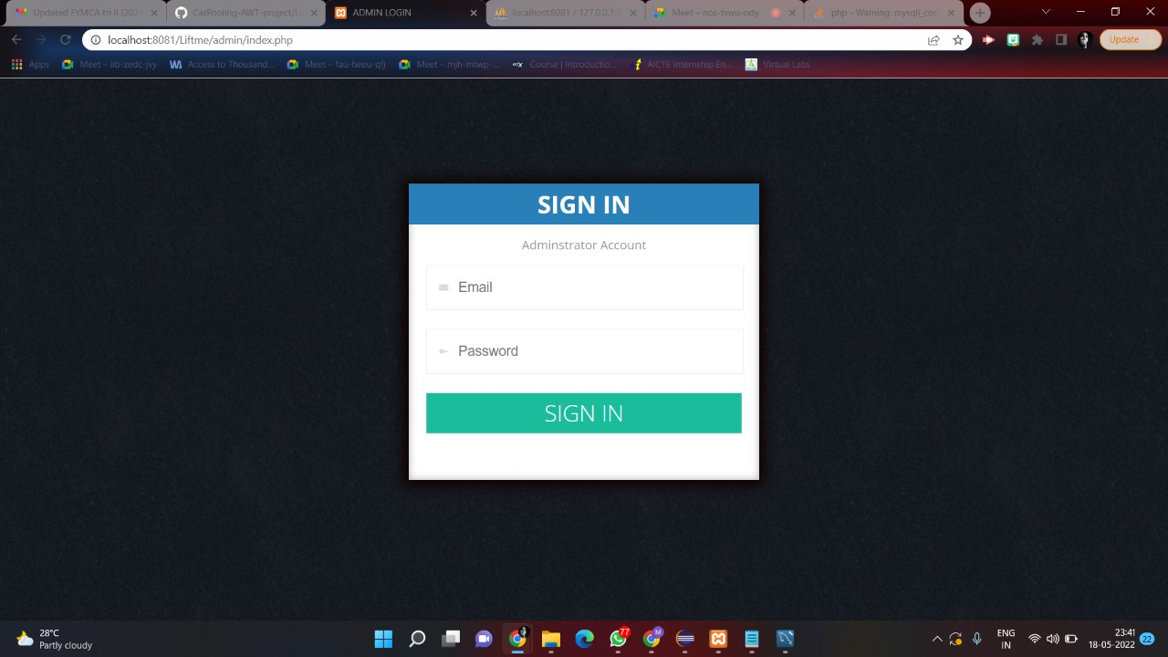

Slide 25
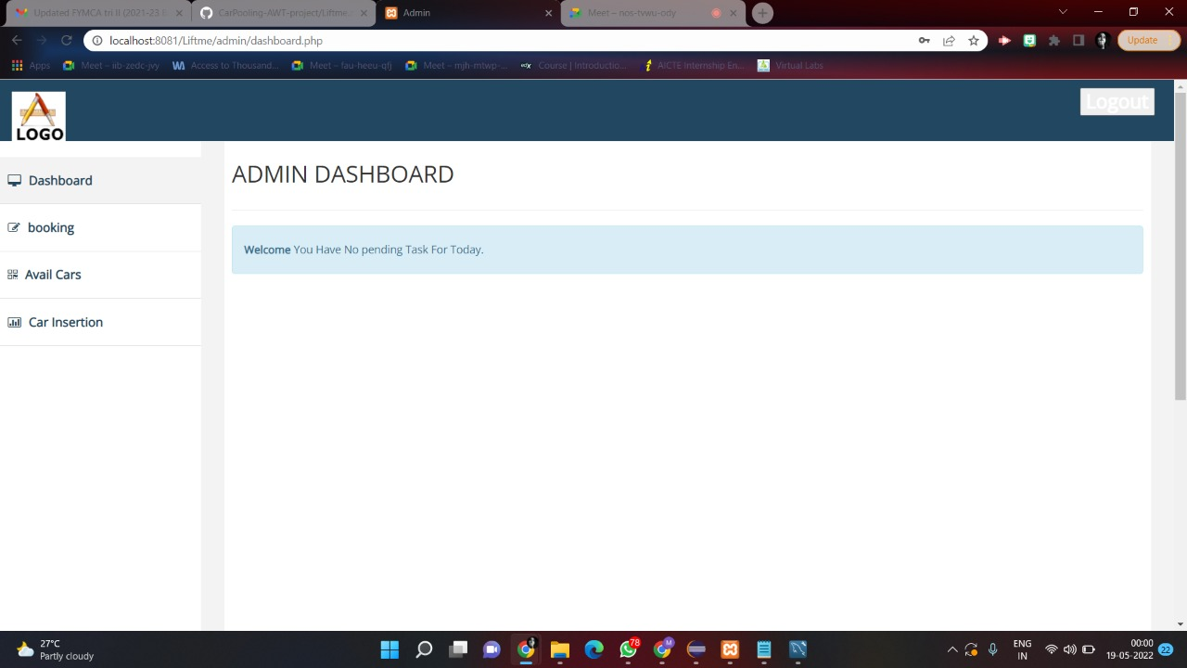

Slide 26
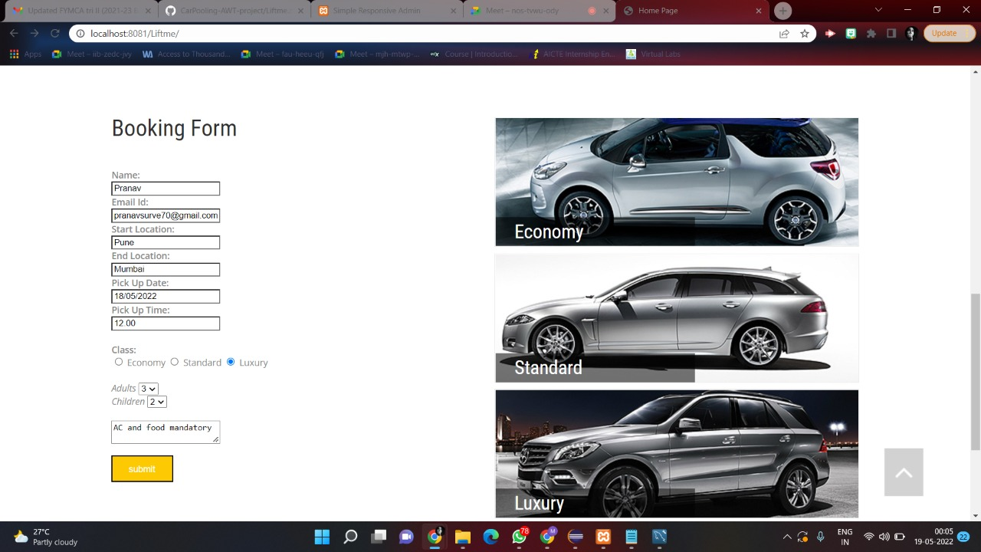

Slide 27
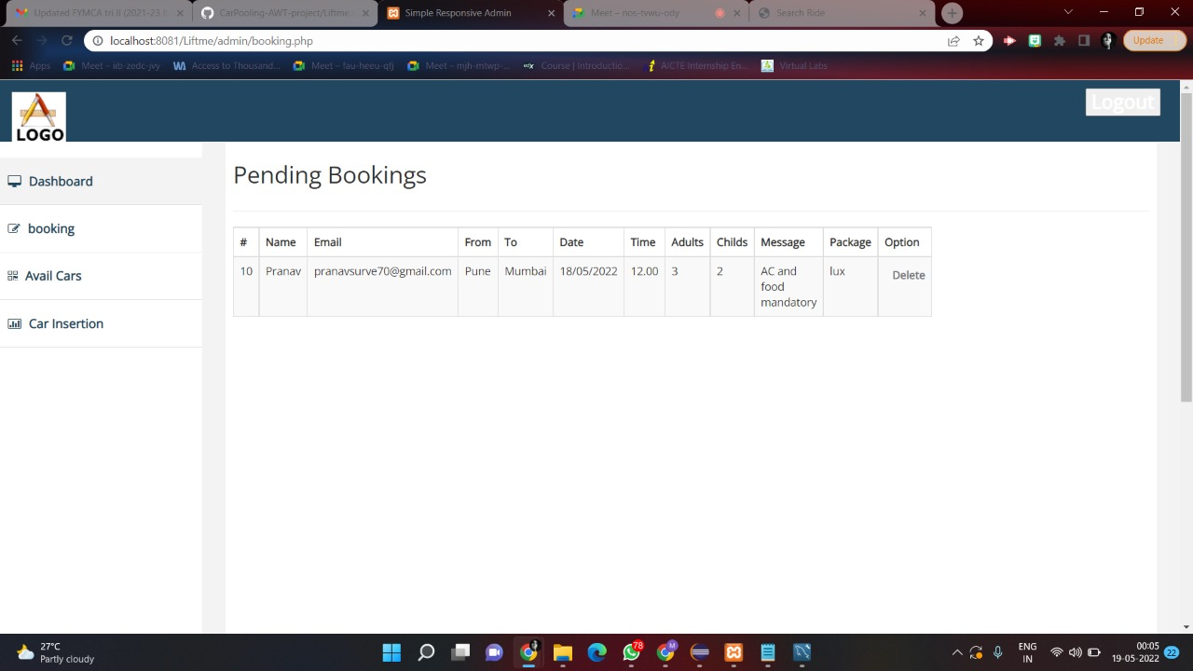

Slide 28
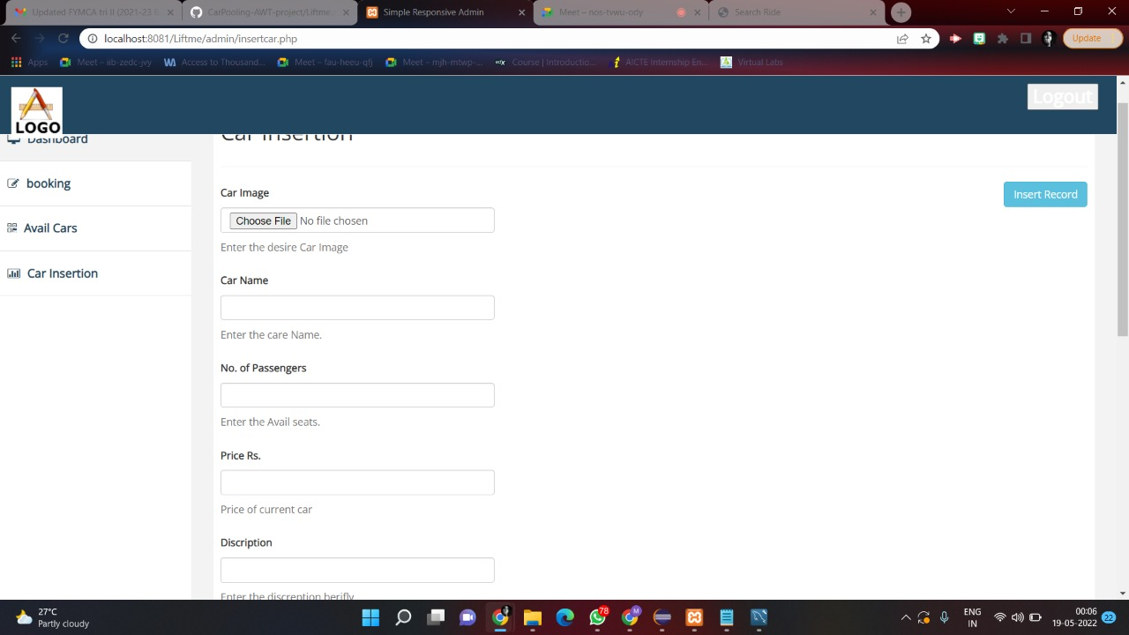

Slide 29
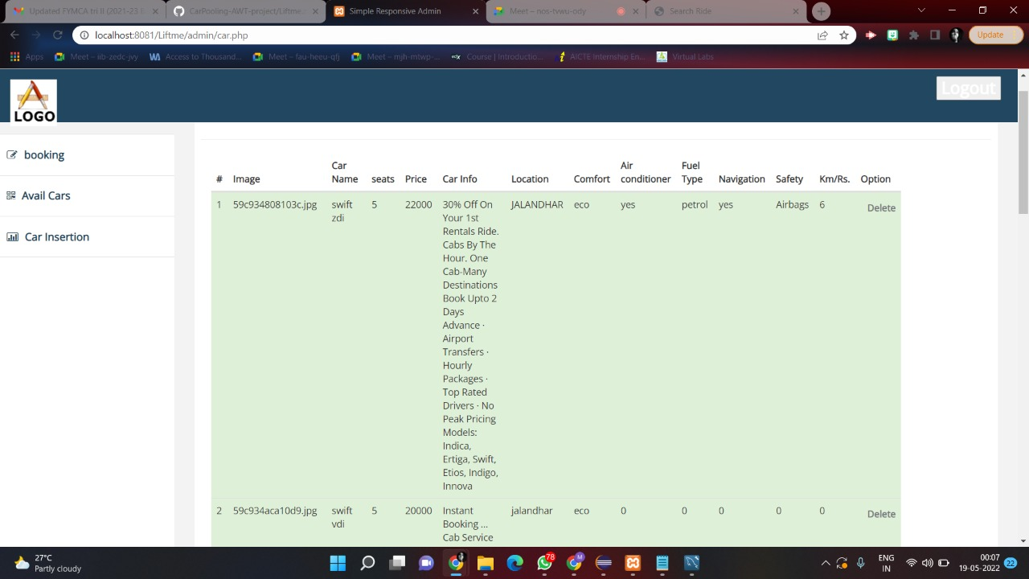

Slide 30
Thank You!

